Slide 1

ACCILERT
The Accident Alert System

Slide 2
Index
1. Introduction
2. Problem Statement
3. Block Diagram
4. Circuit Diagram
5. Concept
6. Components Used
7. Result
8. Literature Survey
9. References

Slide 3
Introduction
Accident Alert System is an IoT based project, which by detecting the accident send the Notification to your love ones, NEARBY HOSPITALS, POLICE STATIONS AND PROVIDES LOCATION TO THE AMBULANCE. PROVIDING FIRST AID by SMARTLY saving TIME by analyzing your Data and even helps you to fight your accident case by much accurate result.
With the integration of Accident Alert System with AirBag Trigger system, the identification of occurrences of Car Accident will be much accurate than the other Mobile based projects which detect the accident with the sensors of mobile which are not as accurate as AcciLERT system.

Slide 4
Literature Review
Sr No. | Title | Author | Publication | Approach | Link
1. | IoT Based Intelligent System For Vehicle Accident and Detection At Real Time | Vivek Kinage, Piyush Patil | IEEE | The proposed system provides indication of alcohol level in driver and the obstacles ahead of the car using the sensors which could prevent accident. | https://ieeexplore.ieee.org/document/9032662
2. | Automobile Black Box System for Accident Analysis | Monisha J Prasad, Arundathi S, Nayana Anil, Harshikha | IEEE | The proposed system makes use of 12 sensors to record the various driving data. The data received from the sensors are stored on the SD card and uses GPS for positioning. | https://ieeexplore.ieee.org/document/7002430
3. | Airbag ECU coupled Vehicle Accident SMS Alert System | Dheeraj Khandelwal, Manoov R | IEEE | The system uses the in-built vibration sensor in the Airbag Electronic Control Unit to detect the abrupt vibrations from the occurrence of an accident and GSM module for SMS | https://ieeexplore.ieee.org/document/8365258

Slide 5
Problem Statement
To Design a module which will help notify the responsible authorities about any serious accidents and then take required automated steps to ease the process of second-aid.
Solution :
We can achieve this by designing a system which,
Detects an accident (sensor based accident detection)
Triggers the Aiding module (activating SOS protocol)
Executes required steps for Second-Aid (Notifying Police, Ambulance and other authorities and providing then with information/data like,
The location of the accident.
Date, time and other SOS.
The SMS will be sent to AcciLERT server, which will further notify based on the Google Map’s API. (Future Scope**)

Slide 6
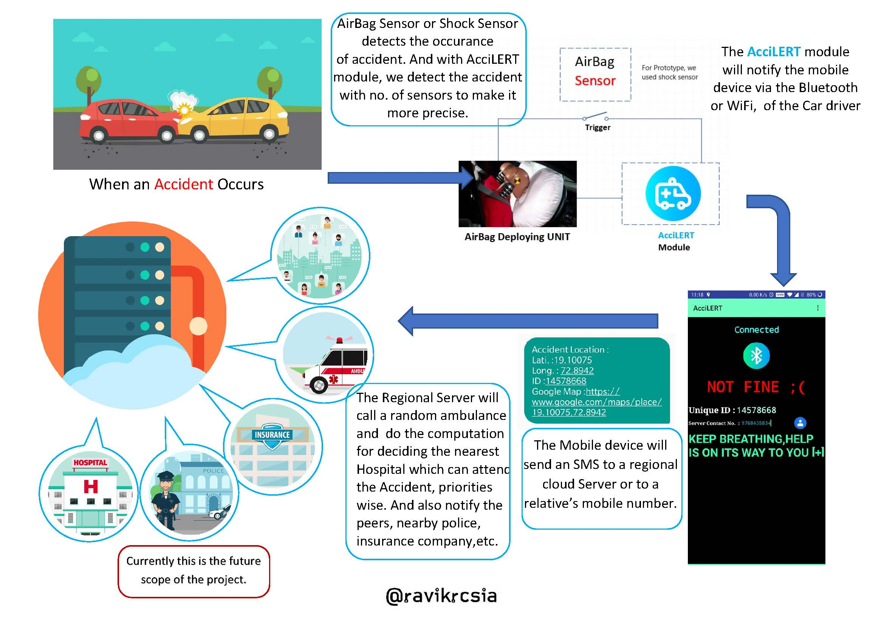
Concept

Slide 7
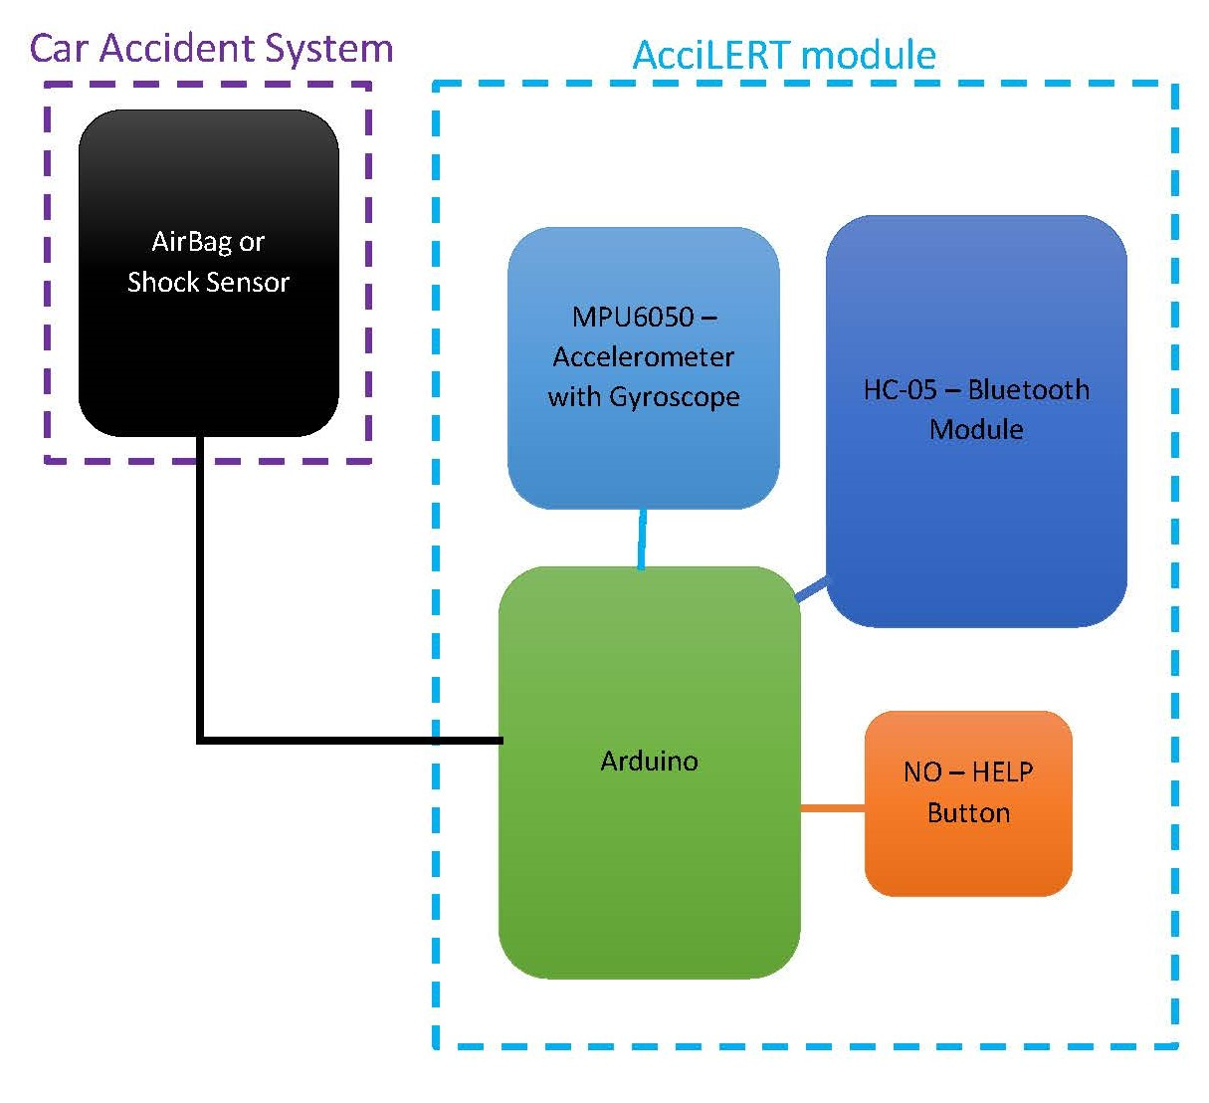
Block Diagram

Slide 8
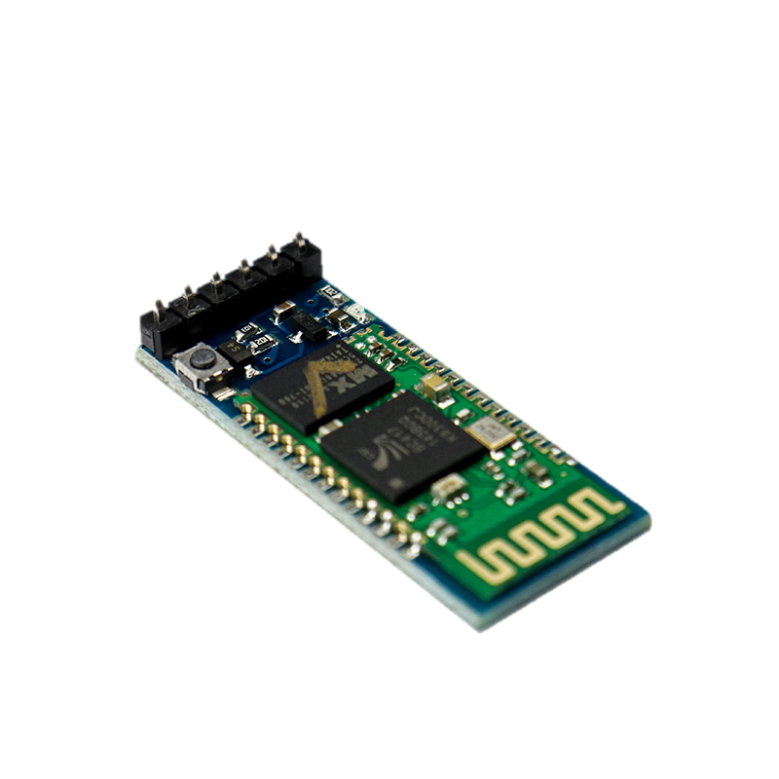
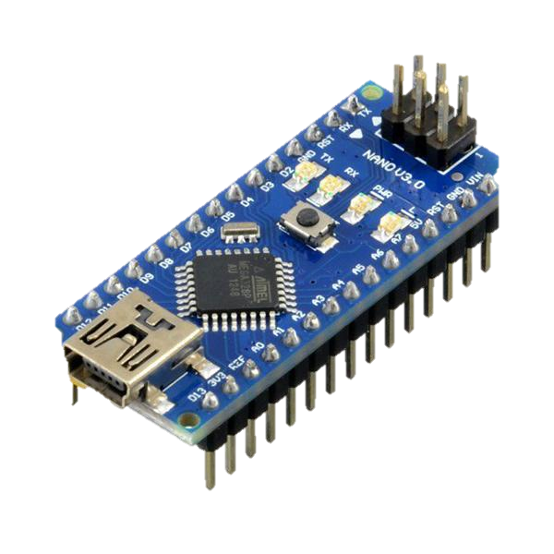
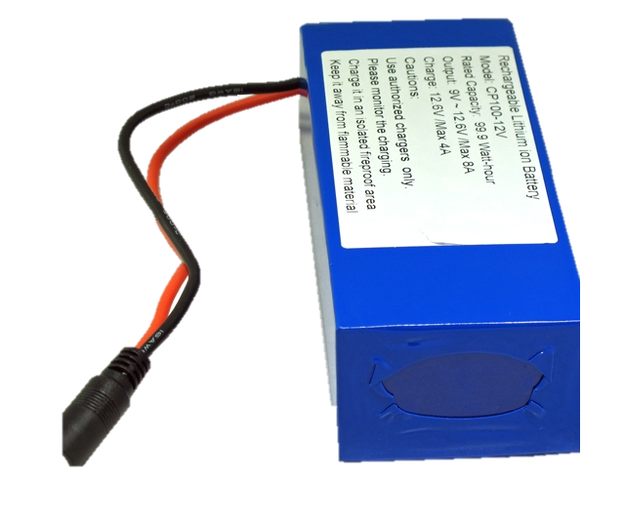
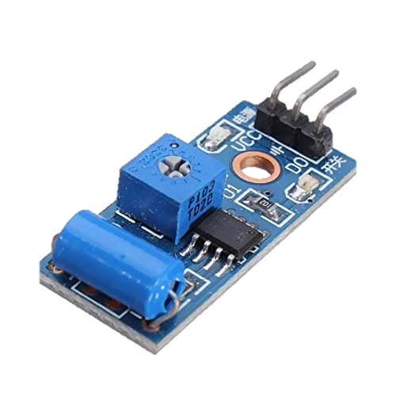
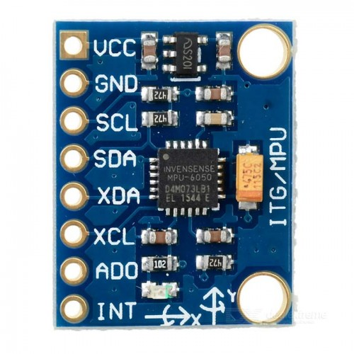


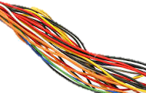
Components Used:
HC05 Bluetooth
Module
Arduino Nano
Power Supply
SW-420 Vibration Sensor
MPU6050 Accelerometer
Airbag Trigger mimic button
Wires
Driver’s Mobile

Slide 9
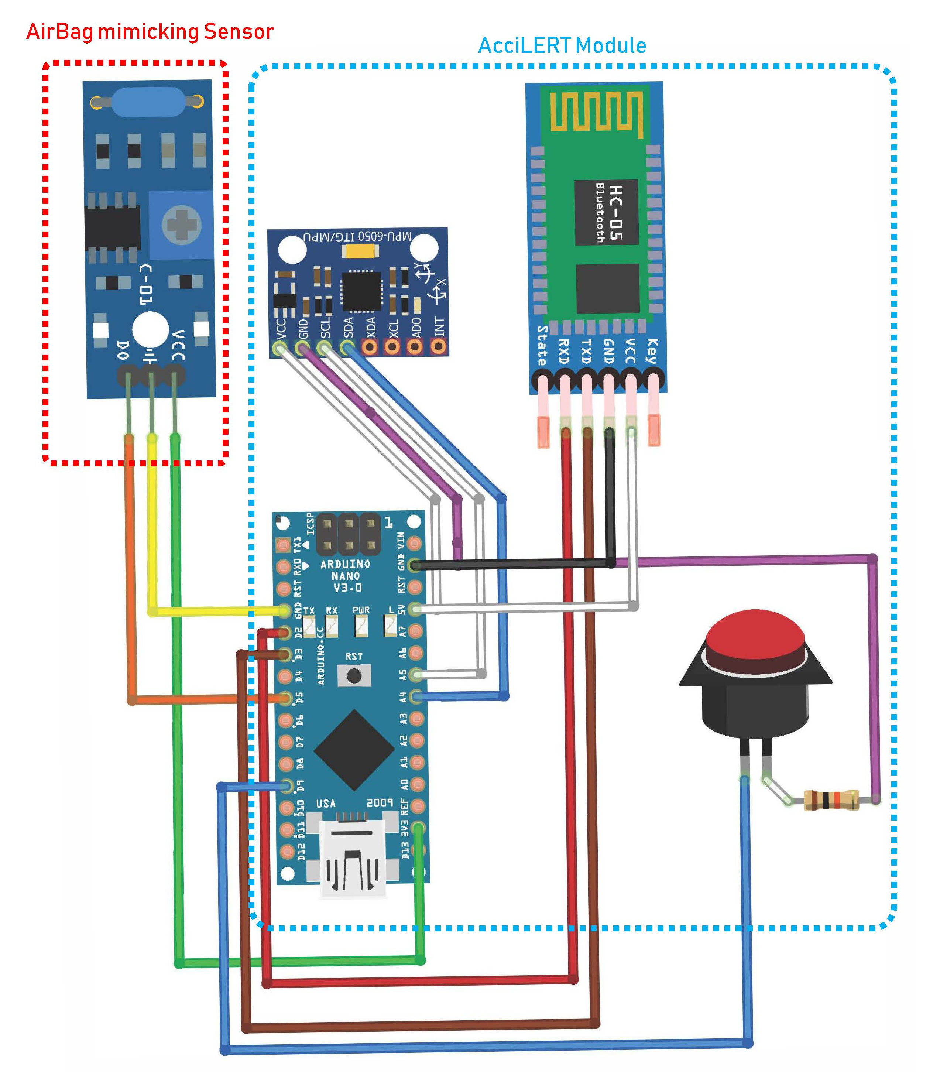
Circuit Diagram

Slide 10
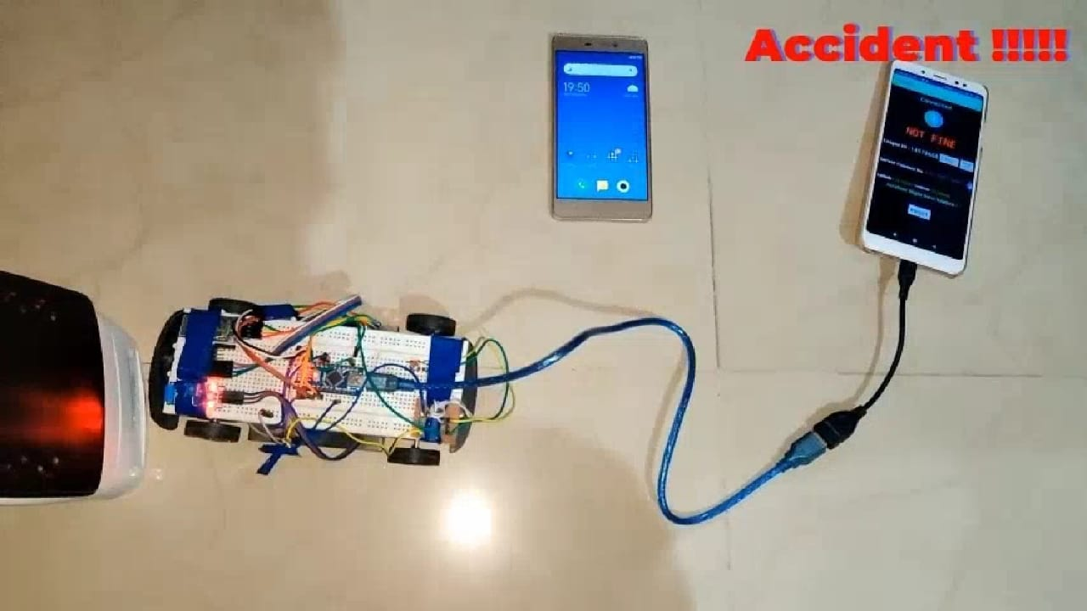
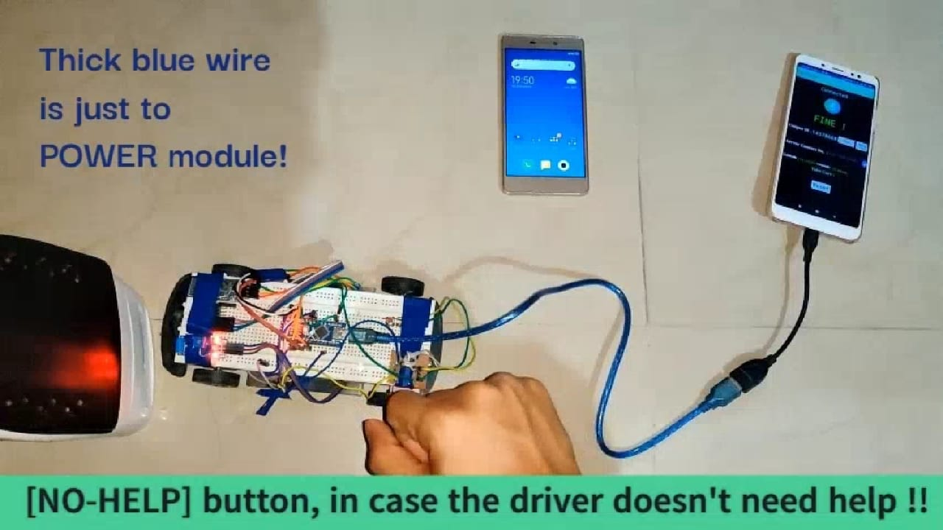
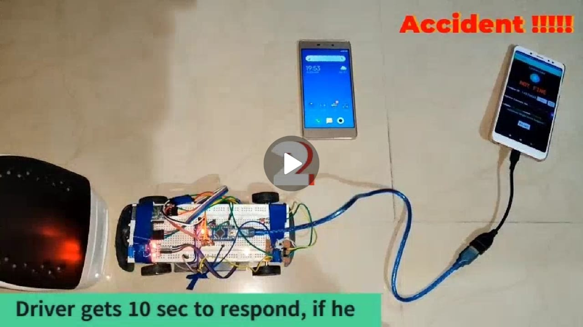
Result
The accident is detected and alerted via sms after 10 secs delay time to confirm that accident is not false alarm.

Slide 11
References
1. IoT Based Intelligent System For Vehicle Accident and Detection At Real Time:
https://ieeexplore.ieee.org/document/9032662
2. Automobile Black Box System for Accident Analysis
https://ieeexplore.ieee.org/document/7002430
3. Airbag ECU coupled Vehicle Accident SMS Alert System
https://ieeexplore.ieee.org/document/8365258
4. Arduino based vehicle accident alert system using GPS, GSM and accelerometer:
https://circuitdigest.com/microcontroller-projects/arduino-based-accident-alert-system-using-gps-gsm-accelerometer
5. Working of the Accident Detection and Alert System using Arduino:
https://bestengineeringprojects.com/accident-detection-and-alert-system-using-arduino/

Slide 12
Thank You
Stay Safe !
Project By-
Bhavya Gada
Ravikumar Chaurasia
Shivangkumar Gandhi

